Slide 1
ELECTRICAL ENGG. DEPARTMENT ELECTRICAL POWER-II 6TH SEMESTER
CHAPTER-5:OVERVOLTAGE PROTECTION
CHAPTER-6: TARIFF
Presented By:
Rajesh Chopra
Lecturer Electrical Engg. Deptt.
G.B.N. Govt. Polytechnic, Nilokheri.

Slide 2
CHAPTER-5
Causes of over voltage :
Internal causes:
(a) Switching surges
(b) Arcing ground
(c) Insulation failure
(d) Resonance
External causes:
Lighting: An electrical discharge in the air between clouds, between the separate charge centres in the same cloud or between cloud and earth is called lighting.

Slide 3
Lighting Strokes:
Direct stroke: It may further classified as A-stroke and B-stroke
Indirect stroke: This is caused by electrostatic induction.

Slide 4
PROTECTION AGAINST OVER VOLTAGE
GROUND WIRES.
EARTHING SCREENS
LIGHTNING ARRESTORS OR SURGE DIVERTERS

Slide 5
Lightning arrester:
It is a device which provides an easy conducting path or relatively low impedance path for the flow of current when the system voltage increases more than the designed value .It behaves as an insulator at normal voltage but provides an easy path for the for the flow of current at abnormal voltages.
TYPES OF LIGHTNING ARRESTER
The following types are protective – against Lightning surges.
1. Rod Gap arrester
2. Horn Gap arrester
3. Expulsion type arrester
4. Electrolytic arrester
5. Thyrite arrester
6. Valve type arrester

Slide 6
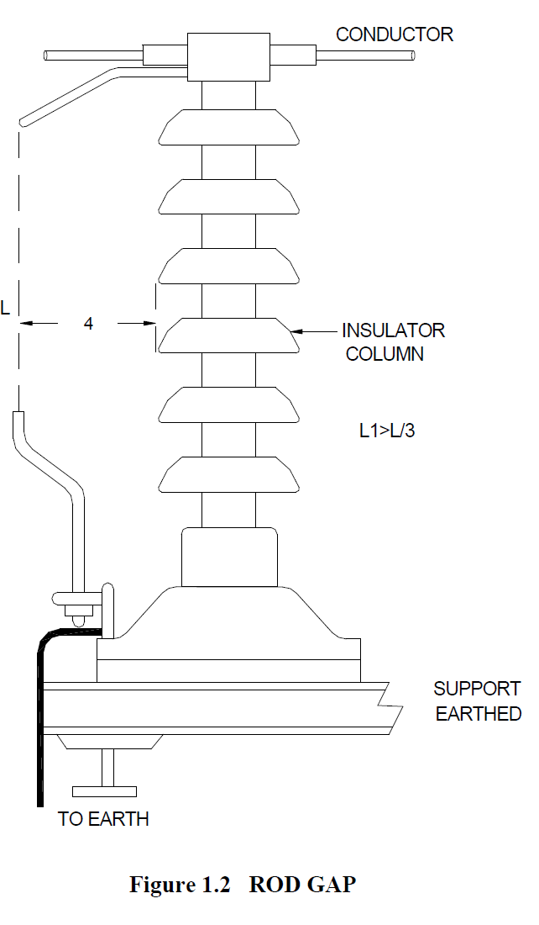
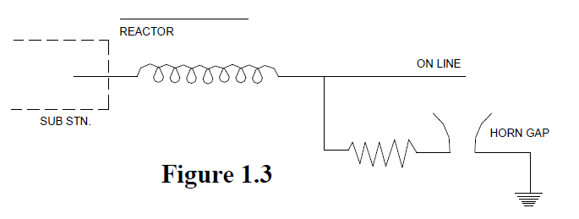
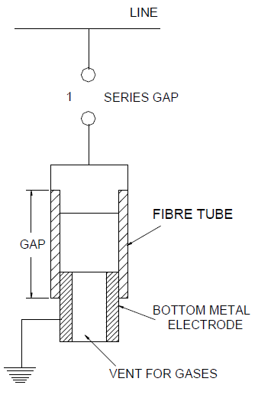
Rod gap arrester
Horn gap arrester
Expulsion type arrester

Slide 7
Chapter-6 Tariff
Tariff:
It is the rate at which energy is supplied to consumers
Tariff types :
Simple tariff
Flat rate tariff
Block rate tariff
Two part tariff
Three part tariff
Maximum demand tariff
Power factor tariff

Slide 8
Simple Tariff
-The price charged per unit energy supplied is constant irrespective of the number of supplied units
- Energy consumption is recorded at consumer’s terminals via an energy meter
- Most simple type, but doesn’t discriminate between types of consumers
Flat rate Tariff
- Consumers are grouped into different classes according to diversity and load factors.
- Each class of consumers is charged at a different uniform rate.
- More fair to different types of consumers & quite simple in calculations.
- Expensive & complicated as separate meters are required for different load types
- Consumers are charged at the same rate irrespective of the magnitude of energy consumed.

Slide 9
Block rate Tariff:
Energy consumption is divided into fixed price per unit blocks. The price per unit in the first block is the highest (or lowest) according to the provider’s necessities and priorities; accordingly, it is progressively reduced (or increased) for the succeeding blocks of energy.
Consumer gets an incentive to consume more (or less) electrical energy. Increased consumption increases the load factor of the system and hence the cost of generation is reduced, nevertheless, it may also overstress a heavily loaded grid with constrained resources, which may in turn imply increasing the cost of generation!!!
- Lacks a measure of the consumer’s demand.
- Used for majority of residential and small commercial consumers.

Slide 10
Two part Tariff:
The total charge is split into two components; fixed charges that depend upon the consumer’s maximum demand, & running charges that depend
upon the number of consumed units.
Total charges = b×kW + c×kWh
-Fixed charges are paid irrespective of consuming or not consuming electric energy
- Assessing consumer's maximum demand is always erroneous
Three part Tariff:
-Comprise fixed, semi-fixed and running charges
Total charges = a + b×kW + c×kWh
- Applied to big consumers

Slide 11
Maximum Demand Tariff
- Similar to “two part” tariff with the exception that the maximum demand is actually measured by installing a maximum demand meter in the consumer premises
- Applied to big consumers

Slide 12
Power Factor Tariff:
- Low power factor should be penalized as it increases the Station’s equipment rating and line losses
(i) kVA maximum demand tariff:
Total charges = b×kVA + c×kWh
(ii) Sliding scale tariff (Average power factor tariff):
Below (or above) p.f. reference results in additional (or discounted) charges
(iii) kW & kVAR tariff :
Both active and reactive power are separately charged

